Slide 1
Beyond the Degree Distribution
Michael Leddy

Slide 2
Overview
Section 10.5 of Network Science by Albert-László Barabási
Degree Distribution
Temporal Networks
Bursty Contact Patterns
Degree Correlations
Link Weights and Communities
Complex Contagion

Slide 3
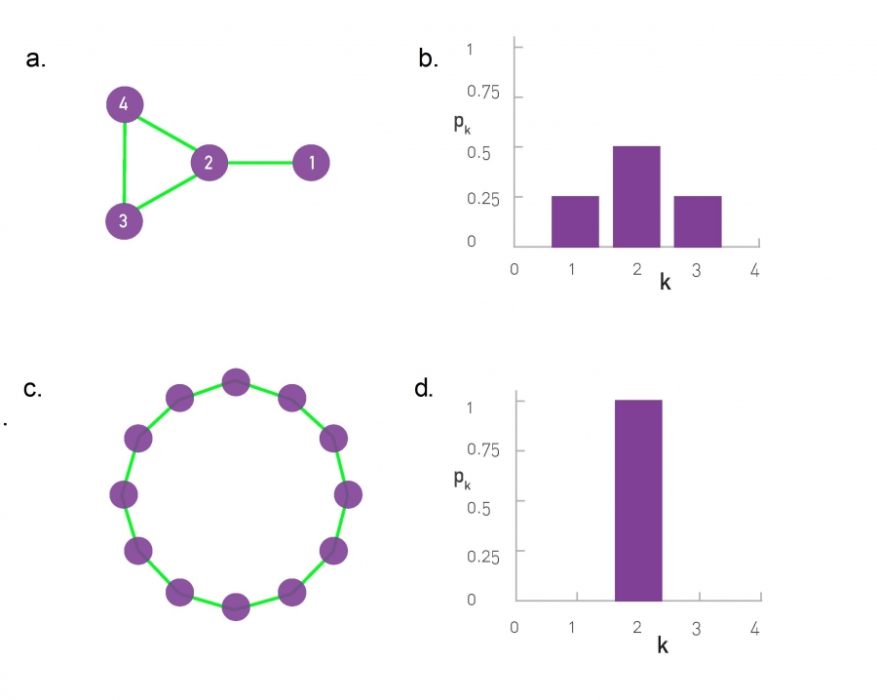
Degree Distribution
The degree distribution of a network is the probability that a randomly selected node has degree k, denoted by p_{k}.
$\sum_{k=0}^{∞}{p_{k}}=1$ – All p_{k} must sum to 1.

Slide 4
Degree Distribution
Regular Network: $p_{k}=\frac{N_{k}}{N}$
N is the number of nodes, N_{k} is the nodes with degree k.
Random Network:
Binomial: $P\left(k\right)=\left({N−1 \atop k}\right)p^{k}{(1−p)}^{N−1−k}$
Poisson: $p_{k}=e^{−\left\langle k\right\rangle }\frac{{\left\langle k\right\rangle }^{k}}{k!}$
Scale-Free Network
Follows power law. e.g. $p_{k}=Ck^{−γ}$, where C is a constant and γ is the degree exponent (also a constant).

Slide 5
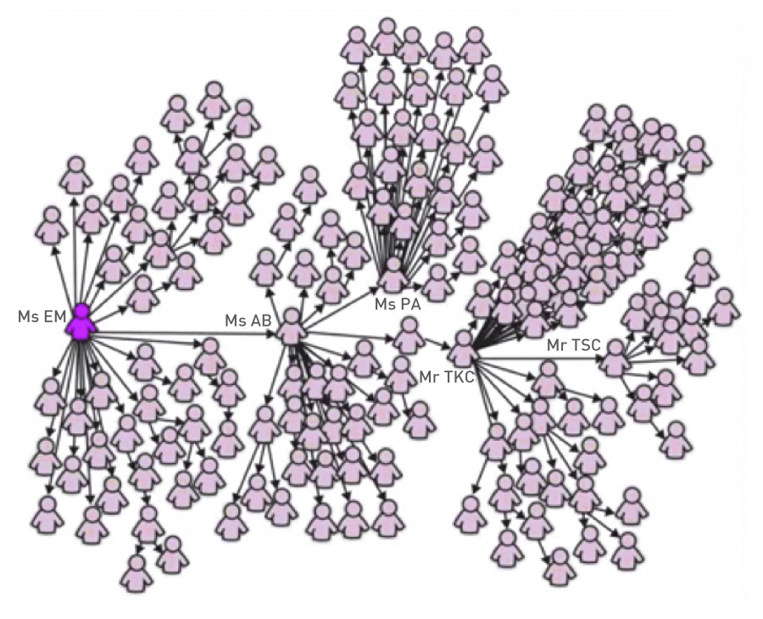
Background
The models used in the chapter up until this point assumed that the spread of an epidemic is based on an unweighted network and its degree distribution.
It is actually more complex than that. These models have to take into various factors into account, such as timing and communities. Also, the edges are typically weighted.

Slide 6
Temporal Networks

Slide 7
Temporal Networks
Temporal networks are networks that take have times as an additional attribute.
In other words, these networks take the timings of each interaction into account.

Slide 8
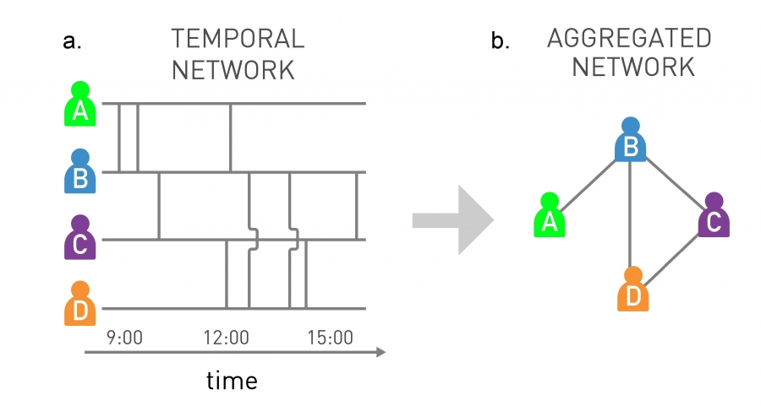
Temporal Networks
In the temporal network, vertical bars between two people denote interactions at the specified time.
The aggregated network is just the interactions without the times.
D can spread a virus to A in the aggregated network, but not in the temporal network.

Slide 9
Bursty Contact Patterns

Slide 10
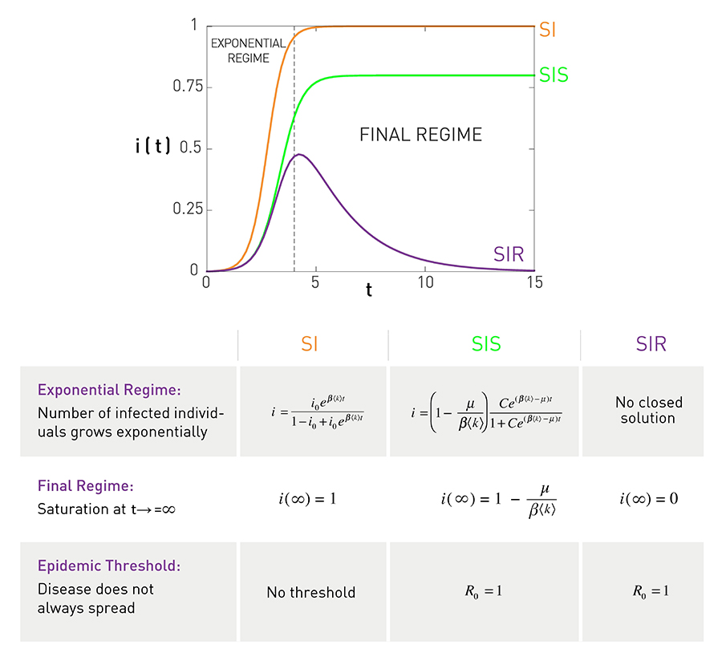
The models used until this point assumed the timings of interactions were random, thus the gaps in timings between interactions result in an exponential distribution, like in the plot to the right.
The gaps of real social networks follow a power law distribution, thus resulting in a series of frequent interactions between two individuals within short time frames. However, this also results in some long time gaps. These patterns are “bursty”.

Slide 11
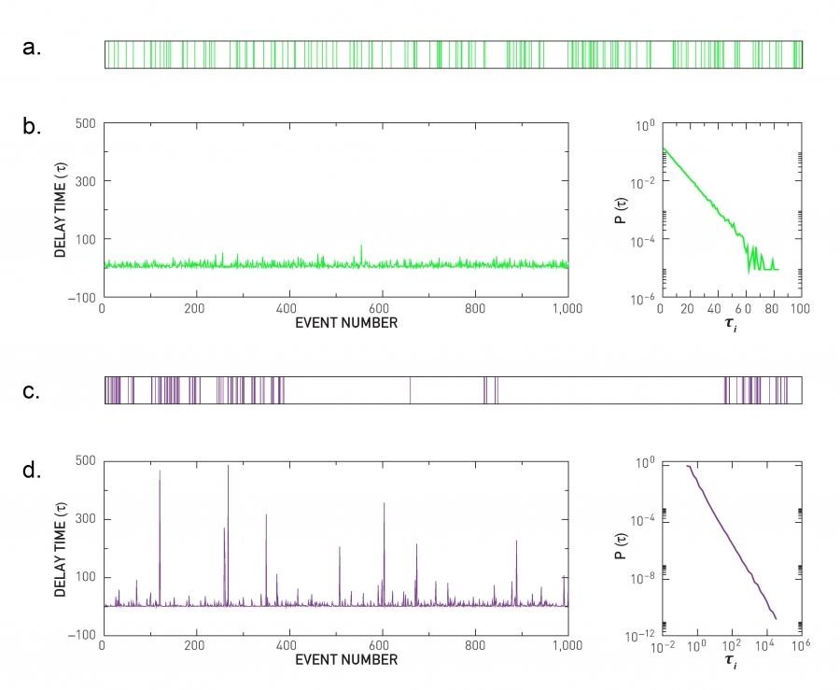
The top plot represents random interactions.
Follows Poisson distribution with probability q.
Interevent times denoted by τ_{i}.
Probability of finding n events in fixed time interval t: $P\left(n, q\right)=e^{−qt}\frac{{(qt)}^{n}}{n!}$
Interevent time distribution:
$$P\left(τ_{i}\right)\sim e^{−qτ_{i}}$$

Slide 12
Notice how the events are uniformly distributed. There aren’t any large gaps.

Slide 13
The bottom plot uses a power law to plot events.
There are a few very large gaps, which are shown by the tall spikes in d.
Interevent time distribution:
$$P\left(τ_{i}\right)\sim τ_{i}^{−2}$$

Slide 14
Bursty Contact Patterns
These contact patterns apply to real life networks, such as email and personal contacts.

Slide 15
Degree Correlations

Slide 16
Degree Correlations
Degree correlations of social networks affect the spread of pathogens along it.
Social networks tend to be assortative, meaning that hubs have a tendency to connect to each other.
Degree correlations do this by affecting the epidemic threshold λ_{c}, the value that the spreading rate of a pathogen needs to exceed in order to spread further. Assortative correlations decrease λ_{c}, while disassortative correlations increase it.
Assortative correlations speed up the spread of pathogens, while disassortative correlations slow them down.

Slide 17
Link Weights and Communities

Slide 18
Link Weights and Communities
Real networks have varying link weights (edge weights) and have structured communities.
Both of these affect the spreading dynamics of the networks.

Slide 19
Link Weights and Communities
Such as the mobile phone network.
The edge weights are represented as the number of minutes two individuals talk to each other over the phone. The weights are represented by w, where weight w_{ij} is the number of minutes on the phone between individuals i and j.
Let the probability of “information” being passed from i to j be represented by $p_{ij}=βw_{ij}$, where β is the spreading probability.

Slide 20
Link Weights and Communities
Communities typically have high edge weights within them, while the edges connecting communities are usually low. This means once something enters a community, it quickly spreads throughout the whole community, but has difficulty leaving it.
If all weights were the same, something will spread throughout the whole network quickly, since that thing will have an easier time leaving a community.

Slide 21
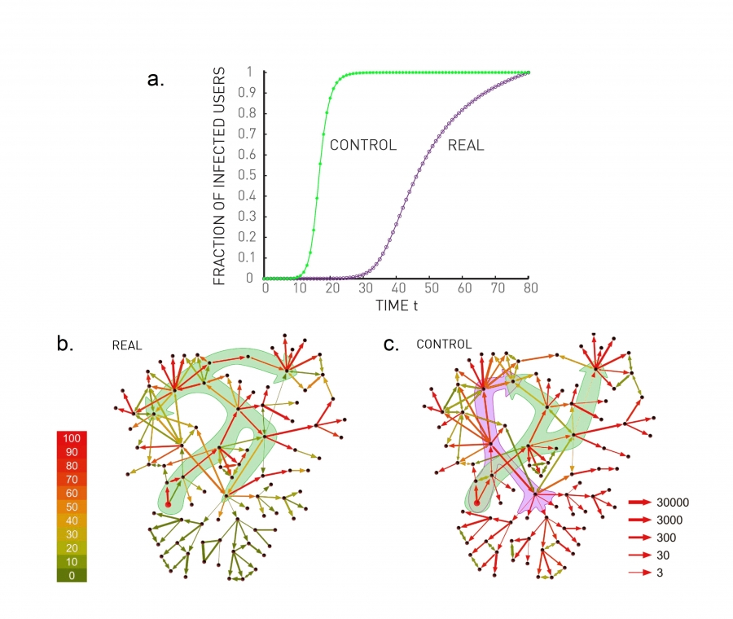
The network with equal edge weights is the “control”.
Simulation was repeated 1,000 times.
Color of edges is the number of transmissions along them.
Size of edges corresponds to the number of transmissions along that direction.

Slide 22
Complex Contagion

Slide 23
Complex Contagion
So far, the models we looked at followed simple contagion, which is where an individual can get infected from simply coming into contact with an infected individual.
Complex contagion requires repeated interactions between individuals in order for a person to become “infected”. This results in slower or condensed spreading.

Slide 24
Complex Contagion
The spread of a pathogen follows simple contagion.
There are many applications of complex contagion, such as the spread of memes. However, memes that go viral spread more like pathogens (simple contagion).

Slide 25
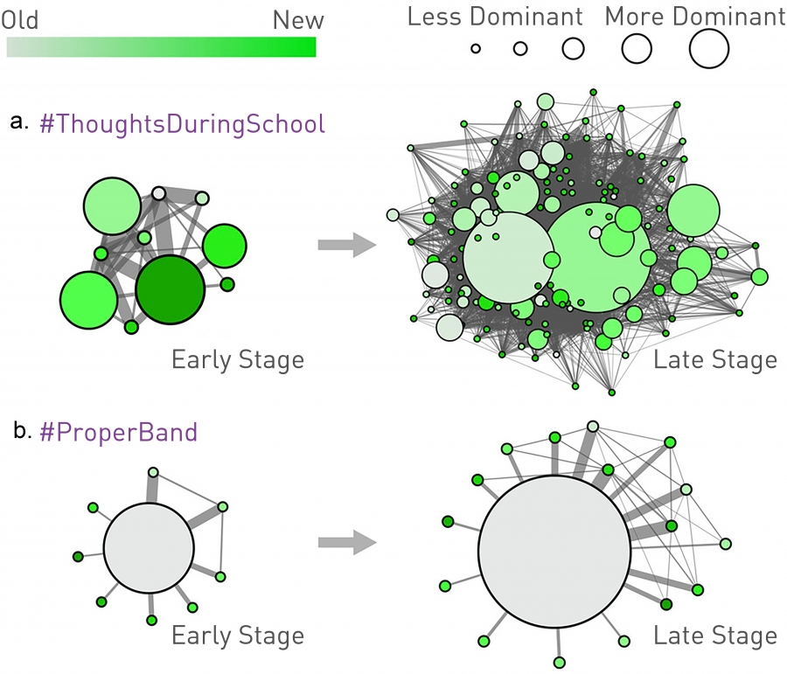

Slide 26
These spreading patterns don’t just apply to infectious diseases like viruses and pathogens. They can apply to non-infectious diseases too.

Slide 27
Do Our Friends Make Us Fat?
A study done by Nicholas Christakis and James Fowler evaluated the BMI of 12,067 people in a social network from 1971 to 2003, a period of 32 years, as part of the Framingham Heart Study.
The study claims that having friends that are obese increases your chance of becoming obese.
“If your friends are obese, your risk of obesity is 45 percent higher. … If your friend’s friends are obese, your risk of obesity is 25 percent higher. … If your friend’s friend’s friend, someone you probably don’t even know, is obese, your risk of obesity is 10 percent higher. It’s only when you get to your friend’s friend’s friend’s friends that there’s no longer a relationship between that person’s body size and your own body size.” – Christakis

Slide 28
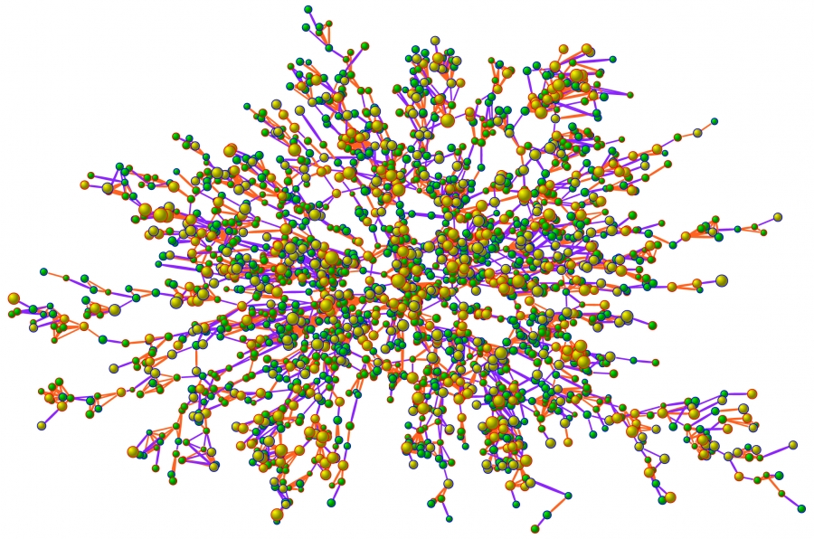
Largest connected component of social network in study (n = 2,200).
Nodes with blue outlines are male, red are female.
Purple links are friendships/ marriages, orange are family ties.
Color/size of nodes correspond to BMI.

Slide 29
Based on the clustering, this diagram follows complex contagion.
This cannot be attributed to homophily.

Slide 30
Conclusion
All of the characteristics discussed in this chapter should be accounted for when making predictions about the spread of a pathogen over a network. Including the timing of interactions, burstiness of contact patterns, degree correlations, link weights, communities, and contagion. The degree distribution simply isn’t enough.

Slide 31
References
Barabási, A.-L. “Chapter 10: Spreading Phenomena” Network Science. http://networksciencebook.com/chapter/10
N.A. Christakis, and J.H. Fowler. The Spread of Obesity in a Large Social Network Over 32 Years. New England Journal of Medicine, 35:370-379, 2007. https://www.nejm.org/doi/full/10.1056/nejmsa066082

Slide 32
Questions?

